Slide 1
AIF Ftp Adapter
Demo

Slide 2
Agenda
Introduction to AIF FTP Adapter
Features & Merits
Configuring AIF FTP Adapter

Slide 3
Introduction to AIF FTP Adapter
What?
Exchanges data between an FTP server and AX server.
Provides on demand information exchange.
Supports two adapters:
Send adapter
Receive adapter
Why?
Currently Dynamics AX does not support any way of exchanging data between FTP servers.
Can upload data up to 300 MB easily.
Provides easy integration of data stored on AX platforms and FTP servers.

Slide 4
Features & Merits
Features
Merits
Easily configurable with Dynamics AX AIF service operations
SSL enabled
Steady excess to any FTP server through inbound & outbound ports
Supports inbound & outbound transform as well
Can conduct large number of transactions
Fastest file transfer protocol
Secured
Allows back and forth transfer
Provides folder view and web view both

Slide 5
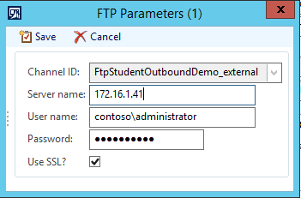
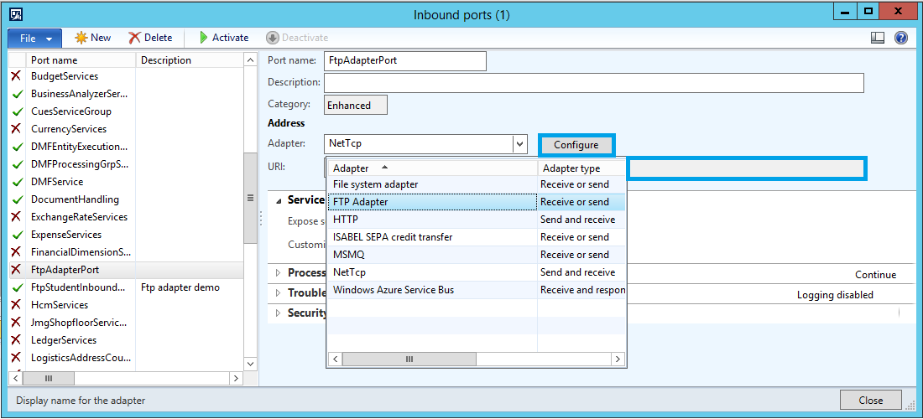
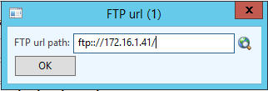
Configuring AIF FTP Adapter

